Slide 1
Competitive Analysis: Portfolos
Michael Yamane

Slide 2
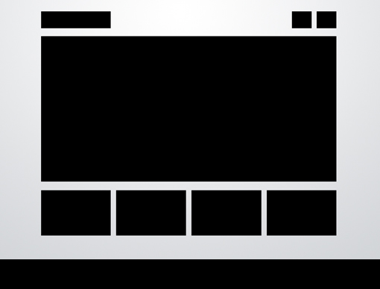
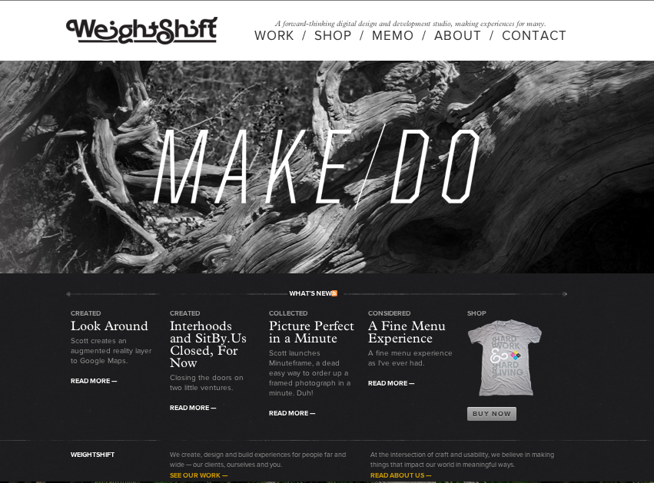
5 Boxes Design
Larger version of the three boxes design.
Allows for more content to be organized.
This layout uses the 5 Boxes Design.
Navigation bar at top, flows down into large image, then divides into categories below.
Presents a lot of information without overwhelming user.

Slide 3
5 Boxes Design Brand
Brand Traits
Professional
Minimalist
Bold
Clean
Greyscale
This portfolio is simple in color choices, but conveys the brand in a dramatic way with the statement “Make/Do”

Slide 4
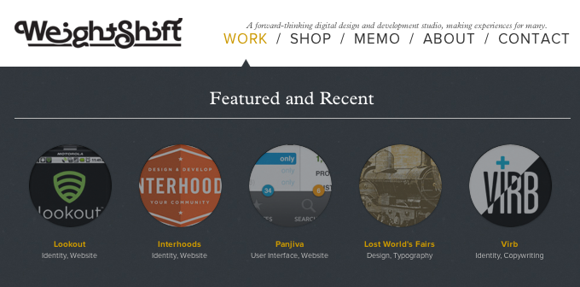
5 Boxes Design Functionality
There are many details which seem to increase as you go deeper into the site from home page to specific works.
The home page is very simple, the portfolio has more information, images, and color contrasts, and each project is even more detailed.
Clearly displays projects through animated circular snapshots.
Each image is a preview of the project which is defined by the caption below, making it very easy to follow.

Slide 5
5 Boxes Design Interactivity
When exploring other areas of the page, the color of the text changes as you mouse over it.
This area of the pages uses more color changing cues to get the attention of the user.
Also, the 5 pieces of work are displayed in a circular shape which enlarges as you mouse over it.
At the bottom of the page there is a twitter link as well as mailing list entry location.

Slide 6
5 Boxes Design Navigation
Navigation flows from top to bottom.
Larger font at top, smaller font at bottom.
Easy to tell where you are in the site, simple flow (visibility).
The main nav remains at the top and the same throughout the site– easy access and visibility.

Slide 7
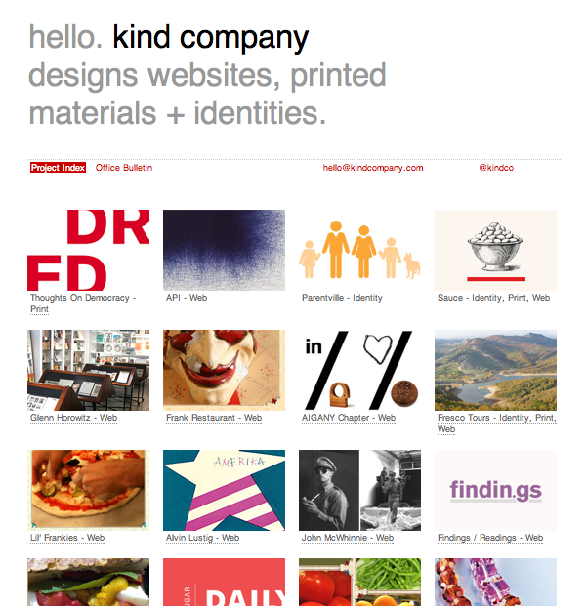
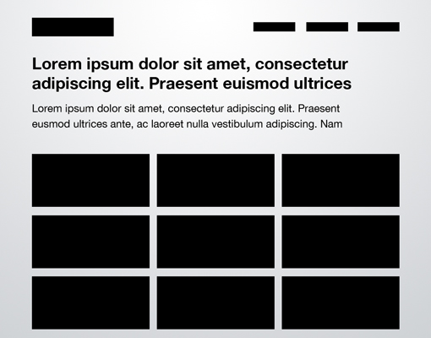
Headline & Gallery Design
Uses a simple headline followed by an array of organized images.

Slide 8
Headline & Gallery Design Brand
Up beat
Minimalist
Family friendly
Detailed oriented
Appeals to the avg/everyday person

Slide 9
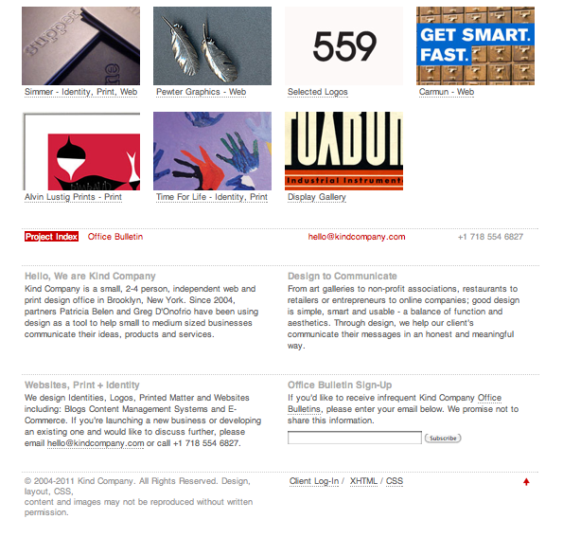
Headline & Gallery Functionality
The top bar as well as bottom bar stay anchored throughout the page so you can easily see the about me section, contact info as well as project index no matter where you are on the page.
The different tiles are easy to navigate through.
The captions underneath each image helps to efficiently go through the portfolio.
There is not a lot of information to distract user, but enough to keep the flow of information.

Slide 10
Headline & Gallery Interactivity
When mousing over main title texts, the color changes.
There are small animations on the different projects when moused over.
No transitions of any kind.
Bottom part of page remains anchored throughout site.

Slide 11
Headline & Gallery Navigation
This site is mainly meant to display the work of the designer.
There are not a lot of different places you can visit easily, besides the work they have done.
This portfolio has an anchored bottom portion which remains the same throughout the site.
Instead of having special tabs at the top, this site just keeps it all at the bottom.

Slide 12
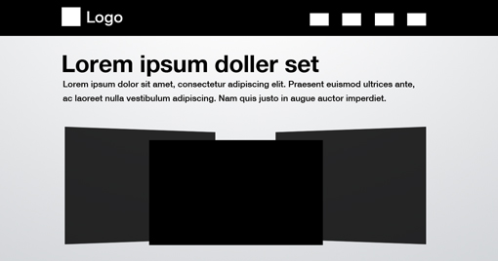
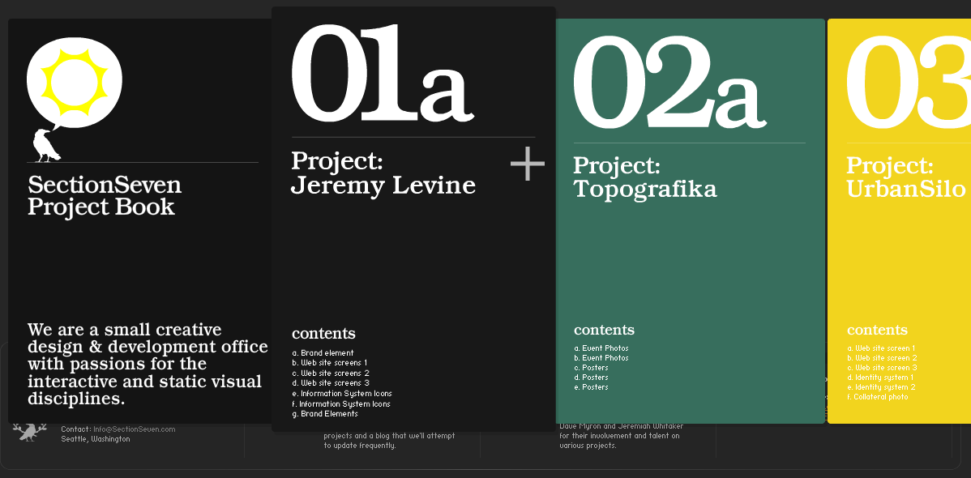
3D ScreenShots
Uses 3D effects to attract attention.
Usually of snapshots of work.

Slide 13
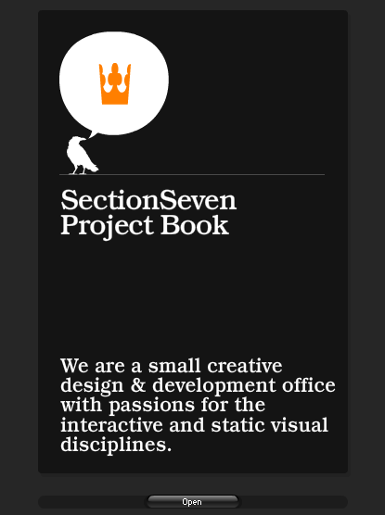
3D Screenshots Brand
The brand stands out with the logo in the top left.
The first page begins by boldly stating their purpose.
Minimalist
Edgy
Clean and detailed driven
Professional
High-caliber

Slide 14
3d Screenshots Functionality
Functionally, this site is lacking some elements that would make it a lot easier to use.
Because of the gallery 3D animations and the layout, it is hard to see the site in the bigger picture sense.

Slide 15
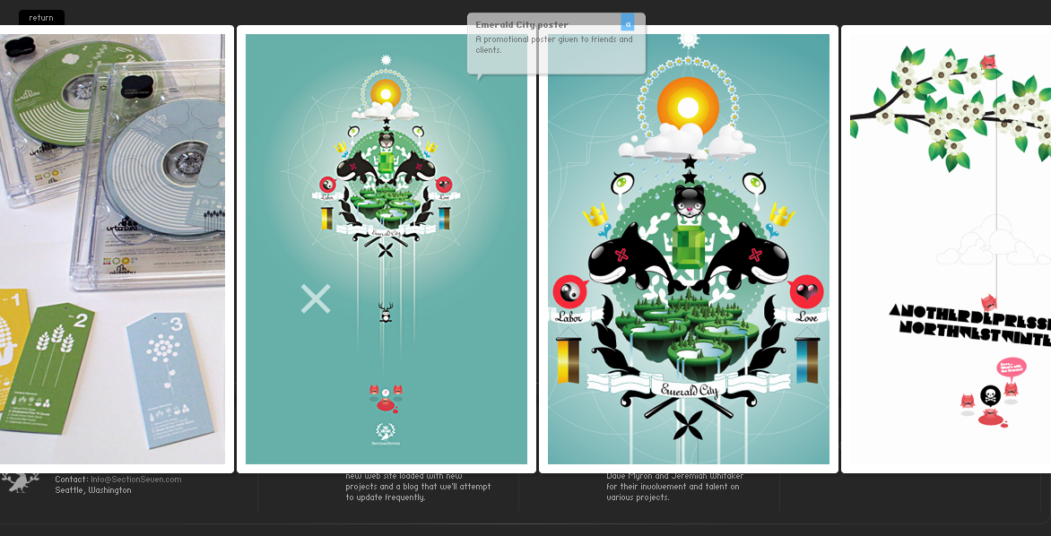
3d Screenshots interactivity
On this site, the cursor becomes a translucent “x”
When scrolling over certain images a url link appears.
After clicking on a project there is a lot of animation, unfolding the images like an accordion.

Slide 16
3d Screenshots Navigation
It is fairly hard to navigate this site because you have to close a project if you want to look at another.
At times there is too much information.
The “contact us” part of this site is a pop-up which needs to be activated by scrolling over a certain area on the screen.

Slide 17
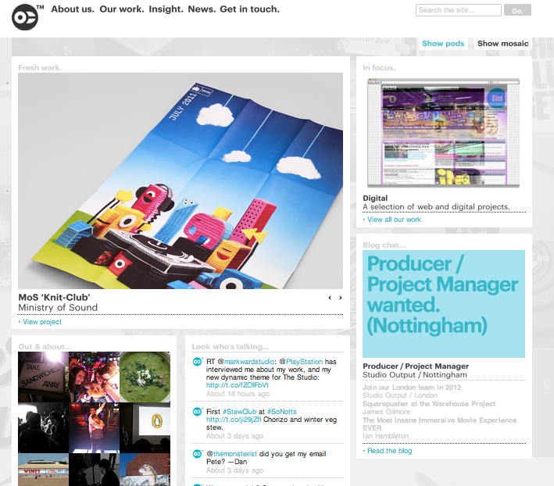
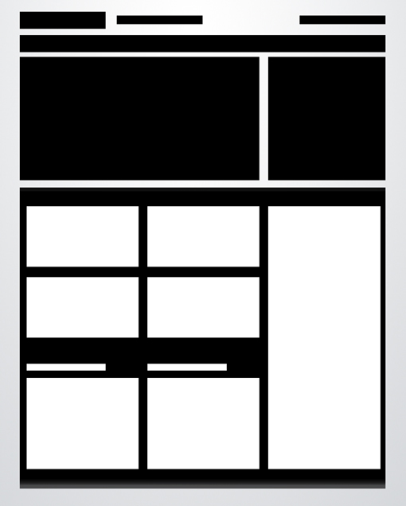
Power Grid
Utilizes many boxes to organize a large amount of information.

Slide 18
Power Grid brand
Brand Traits
Clean
Simple
Modern
This site uses a small logo in the top left corner.
Fairly simple design and color scheme convey neatness.

Slide 19
Power Grid Functionality
Although it may not seem like there are a lot of projects based on the home page, there are many in-depth supplementary project pages (organized in a grid pattern).
This site functions very well, the captions are clear and concise.
There are no overwhelming animations.

Slide 20
Power Grid Interactivity
This site has the option of two separate view modes; mosaic and grid.
Different parts of the site use different animations and layouts to keep the scene changing.
Images are slightly enlarged when moused over.
There is a small photo slideshow on the home page.

Slide 21
Power Grid Navigation
The top bar remains the same throughout the site, which provides easy navigation.
A search box is provided to find anything on the site.
In addition to the main categories, there are also subcategories which help navigate to popular places on the site.

Slide 22
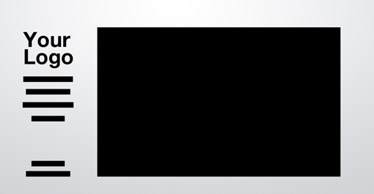
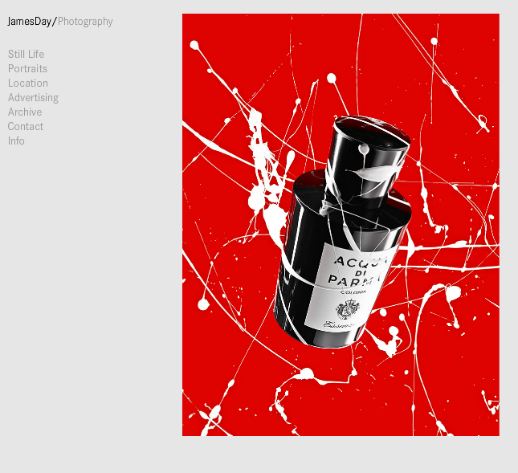
Featured Photo
Using a photo as the main attraction on the site.

Slide 23
Featured photo brand
Brand Traits
Expressive
Simple
Dignified
Studio
By having a single image from the collection as the home page, it makes a dramatic statement to the user.

Slide 24
Featured Photo Functionality
Functionally, this site is very simple and easy to use.
Because this is a photography portfolio there are very few words. The side bar serves as the hub of the site and easily guides to other parts of the site.
Once clicked on the pictures have annotations and links to external sites.

Slide 25
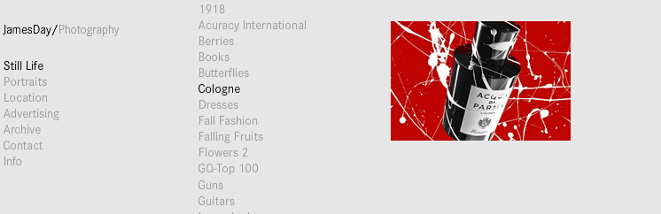
Featured photo interactivity
When mousing over a subcategory, the images begin to animate on the left of the word. From there, you can click on the picture, which animates into the project page.
Animation is used to cycle through photos at high rates of speed.

Slide 26
Featured Photo Navigation
The navigation on this page is very basic and simple, yet very specific.
Using animations and lists, one can view a large quantity of work in a short amount of time.

Slide 27
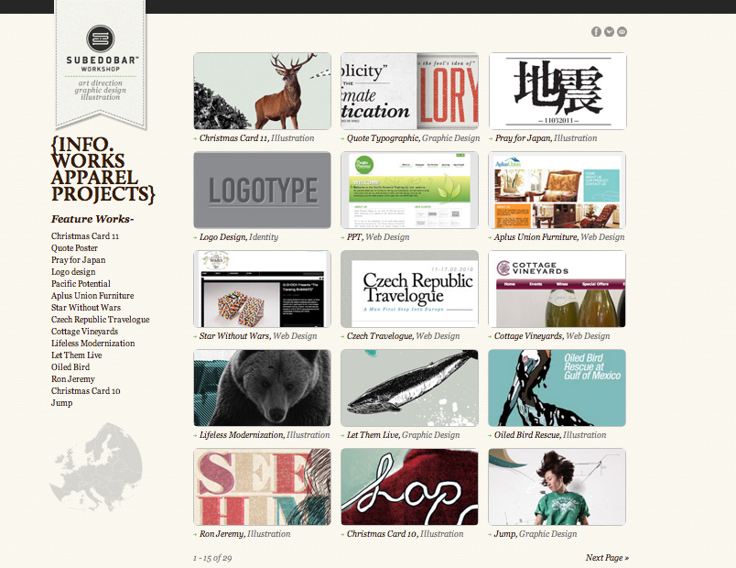
5 Other Designs
http://www.subedobar.com/
Brand | Functionality | Interactivity | Navigation
The brand establishes itself with its display of work; typography. Brand Traits; Versatile, modern, clean, simple. | After selecting a piece from the grid, the picture is displayed slightly larger and is not presented in a full manner. Missing descriptions for work, nicely made, but lacking content. | Twitter, Facebook, tumblr links. Client and partner links at bottom of page. Color change with mouse over. Slight color change on images as they are selected. | The sidebar on the left helps navigate to different page areas, but slightly confusing/unorganized. Simple grid layout helps streamline na

Slide 28
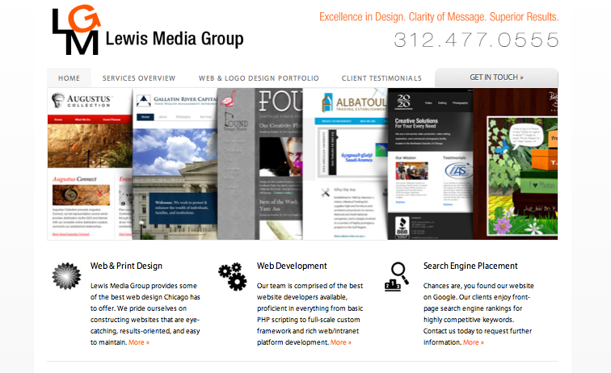
5 other Designs
http://www.windycitywebsites.com/
Brand | Functionality | Interactivity | Navigation
Brand Traits; clean, simple, flexible. Older demographic. Wide array of work in first page. | Missing descriptions for work, nicely made, but lacking content. Nicely embedded links to work. | Twitter, Facebook, tumblr links. Images scroll down in line with cursor. | Pop out nav bar on side allows for easy access to work. Top of page remains constantly fixed, easy to go back to home page.

Slide 29
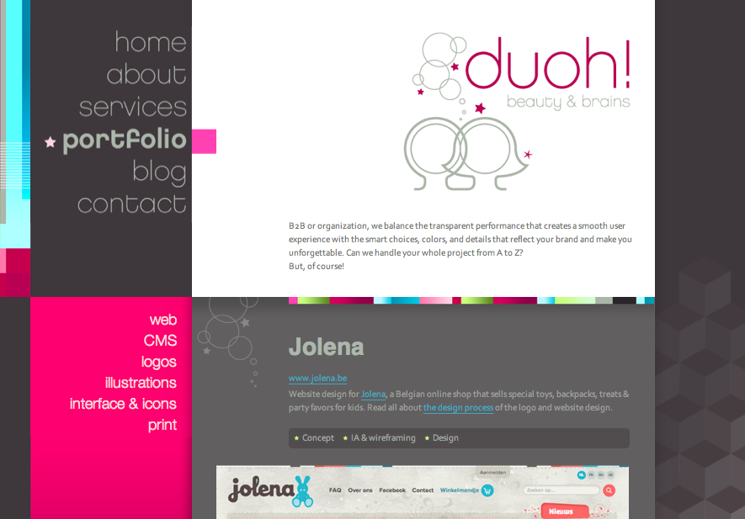
5 Other Designs
http://www.duoh.com/portfolio
Brand | Functionality | Interactivity | Navigation
Brand Traits; modern, chic, simple, feminine Use of color and bubbly illustrations convey a feminine touch. | Filters allow to search for specific types of work. Side bars are unique for each category. Descriptions of projects provided. | Color change with mouse over. Slight color change on images as they are selected. Filters used on homepage. | The sidebar on the left helps navigate to different page areas. Highlighting lets you know where you are.

Slide 30
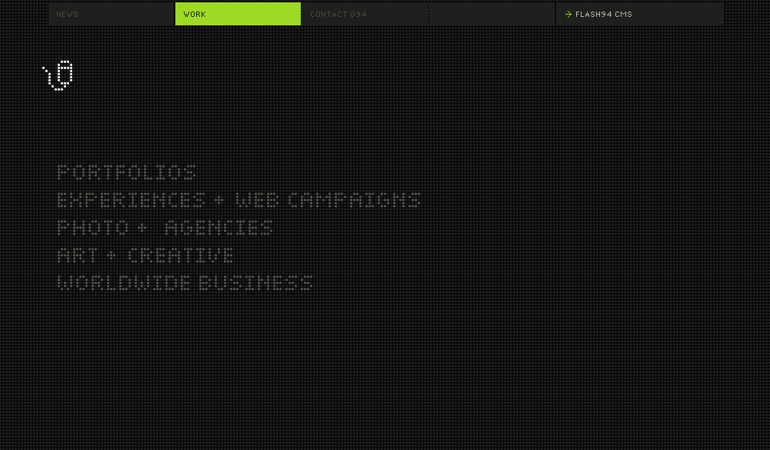
5 other Designs
http://www.group94.com/#/website/work
Brand | Functionality | Interactivity | Navigation
Brand Traits; modern, futuristic, digital, cutting edge, trendy. | Has descriptions for pieces of work. Uses filters to narrow down results. | Animated with pixels which explode from cursor. Color change with mouse over. Slight color change on images as they are selected. Images displayed in background, always in animation | Filters to specify which type of work to view. Nav bar is always on top. Highlighted to show current location. Uses Flash animation for transitions.

Slide 31
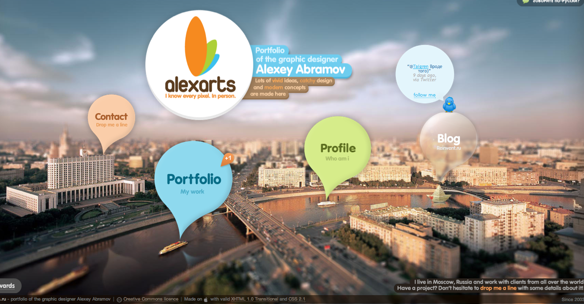
5 other designs
http://alexarts.ru/en/index.html
Brand | Functionality | Interactivity | Navigation
Brand Traits; fun, young, artistic, innovative. | Portfolio uses a pop-up section to present work with nicely embedded links and pictures. | Twitter, Facebook, tumblr links. Client and partner links at bottom of page. Object size change with mouse over. | The balloon layout presents information across screen in a non-uniform way, still simple to navigate through. Uses pop up windows, to return home; close windows.

Slide 32
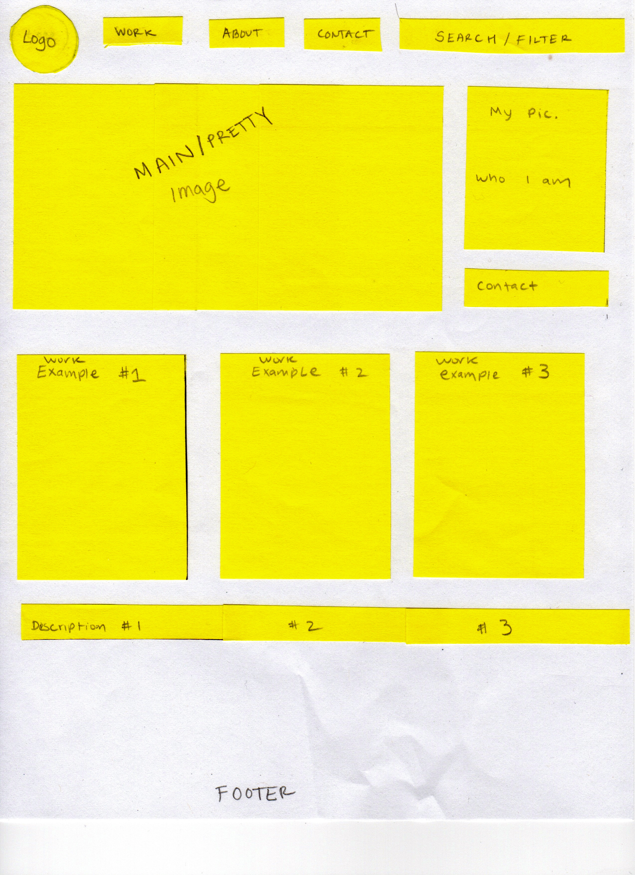
Sketch

Slide 33
Websites Used
http://www.weightshift.com/
http://www.kindcompany.com/
http://www.sectionseven.com/index2.html
http://www.studio-output.com/
http://www.jamesdayphoto.com/
http://www.subedobar.com/
http://www.windycitywebsites.com/
http://www.duoh.com/portfolio
http://www.group94.com/#/website/work
http://alexarts.ru/en/index.html

